Slide 1
Predicting Home Availability in Washington, DC
Diego Rodriguez

Slide 2







Slide 3
Problem Statement
I Want to:
Uncover home availability in Washington DC

Slide 4
How?
By analysing housing sales data from Office of Tax and Revenue website

Slide 5


Notes:
The OTR property tax database provides online access to property information

Slide 6
My Scraped Dataset
Over 50,000 rows
Categorical Variables
Addresses, Neighborhoods, Names of Owners, Assessor, Tax Type (residential, commercial, etc)
Numerical Variables
Sale Prices, Land Values, Assessment Values

Slide 7
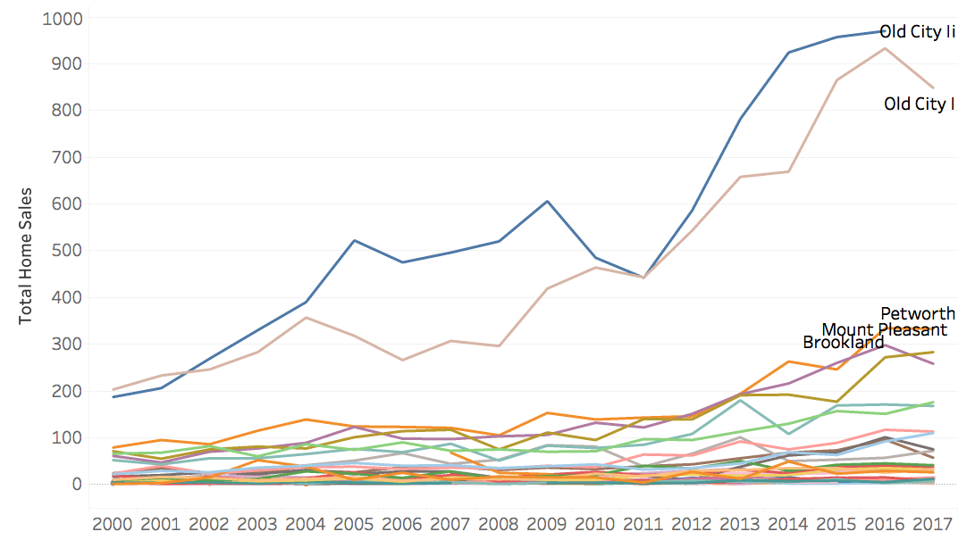
Where are there the Most Home Sales?

Slide 8
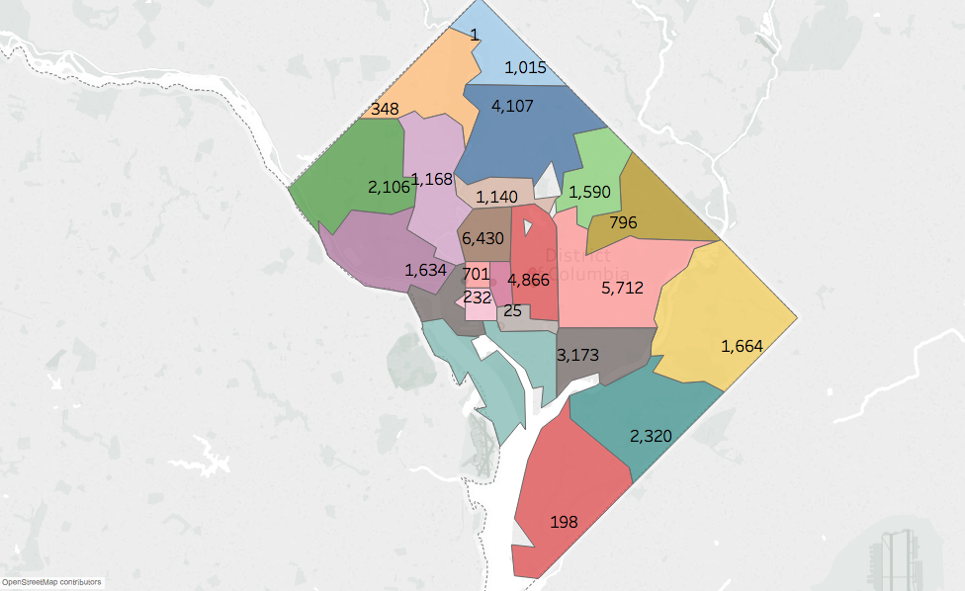
What Are Old City I and II ?

Slide 9
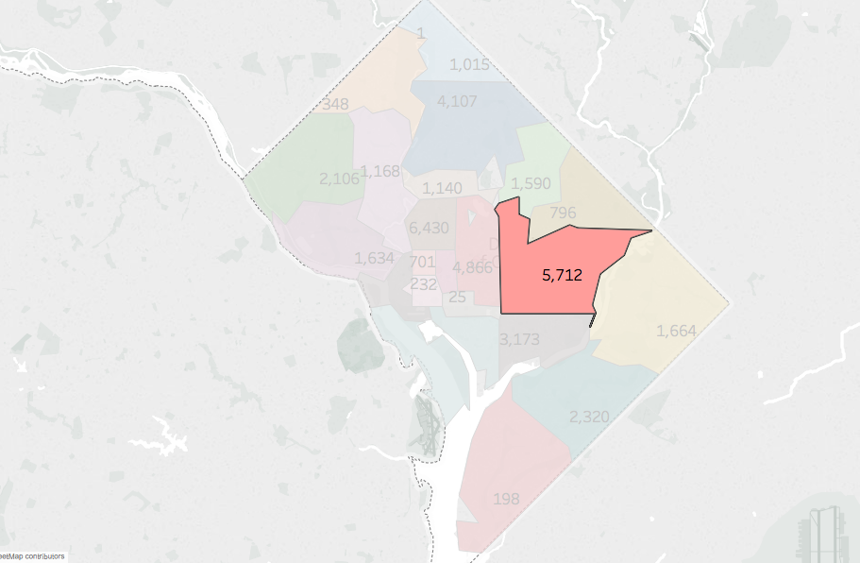
What Are Old City I and II ?

Slide 10
Why ARIMA?
Great for Time series Data
Accounts for parameters we can miss with linear regression
We do lose interpretability, but we get a better sense of performance over time

Slide 11
The ARIMA Time Series Model
Three distinct integers (p, d, q) that parametrize ARIMA
p is the auto-regressive part, incorporates effect of past values (sales today if there were sales yesterday)
d is the integrated part, incorporates differencing (i.e. the number of past time points to subtract from the current value) to apply to the time series.
q is the moving average part, we set the error of our model as a linear combination of the error values observed at previous time points in the past.
Notes:
Intuitively, this would be similar to stating that it is likely to be same temperature tomorrow if the difference in temperature in the last three days has been very small.

Slide 12
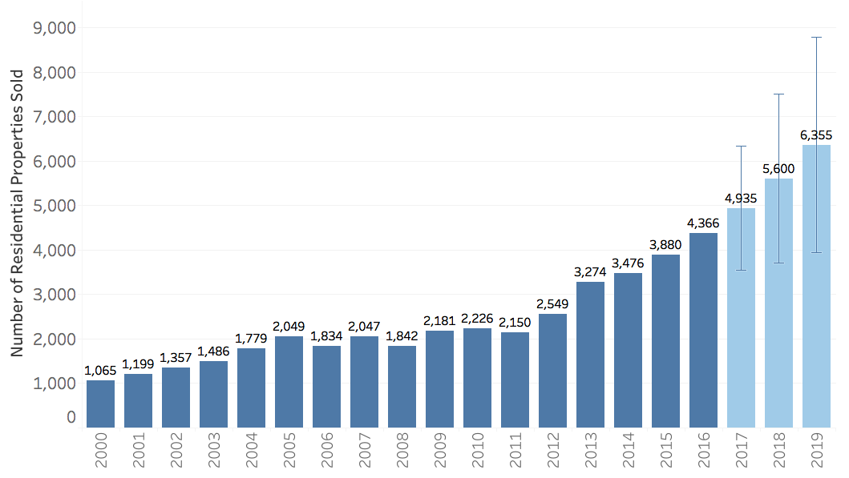
Home Sales In DC, 2000 - 2017 (and Beyond)

Slide 13
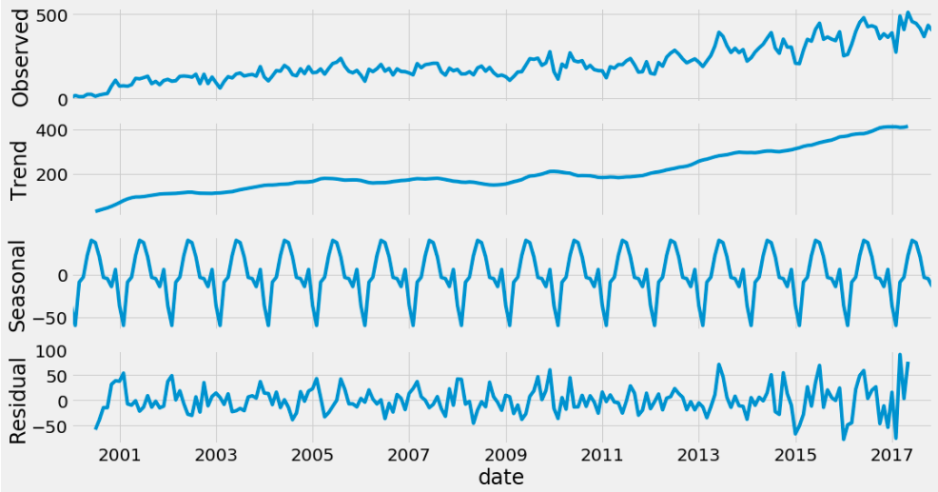
Investigating Decomposition

Slide 14
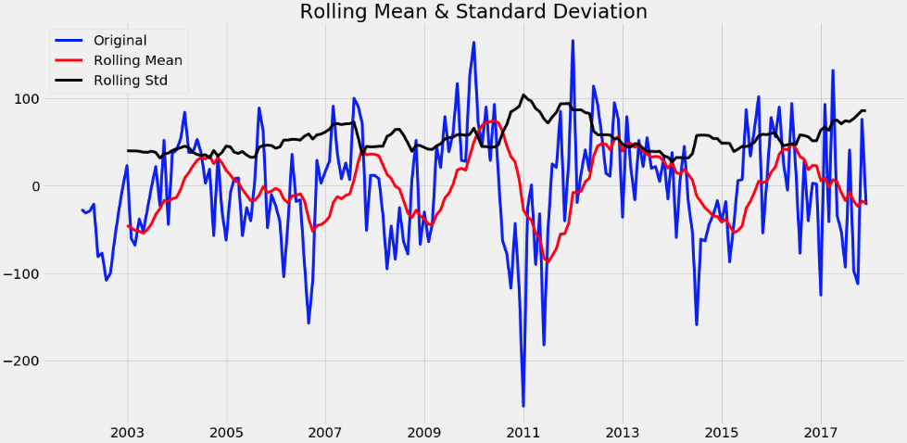
Testing For Stationarity

Slide 15
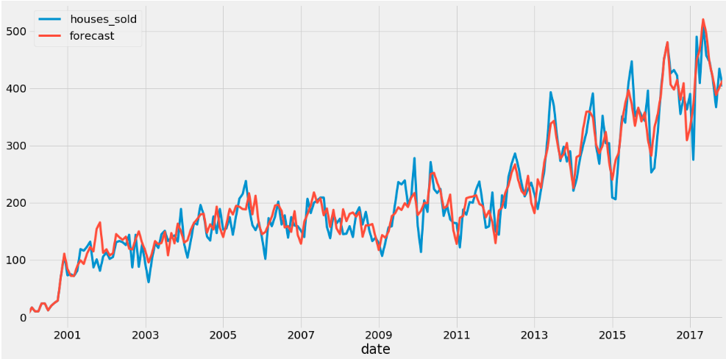
How My Model Performed

Slide 16
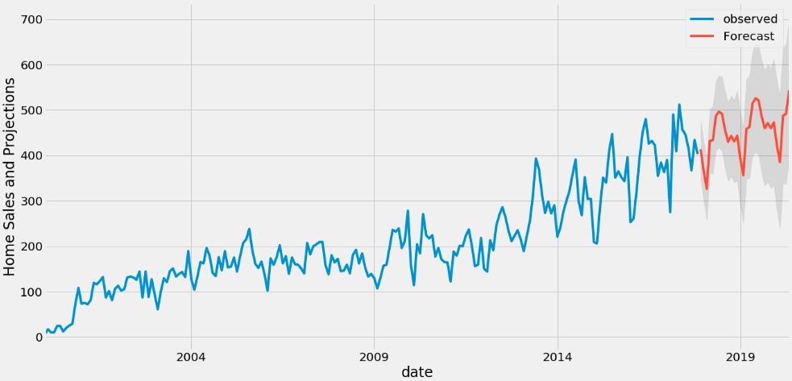
The Future?

Slide 17
Findings
The general home sales trend is up!
“Old City” continues to have the highest rate have sales (availability)
ARIMA is a good estimator for predicting home trends in DC

Slide 18
Next Steps
Exploring Localities
Continued Forecasting On a Zip Code and Neighborhood Level

Slide 19
Questions? | Thank You!

